Slide 1
Computational Design of Transforming Pop-up Books
NAN XIAO and ZHE ZHU
Tsinghua University
RALPH R. MARTIN
Cardiff University
KUN XU and JIA-MING LU and SHI-MIN HU
Tsinghua University

Slide 2


Photography &
Recording Encouraged

Slide 3
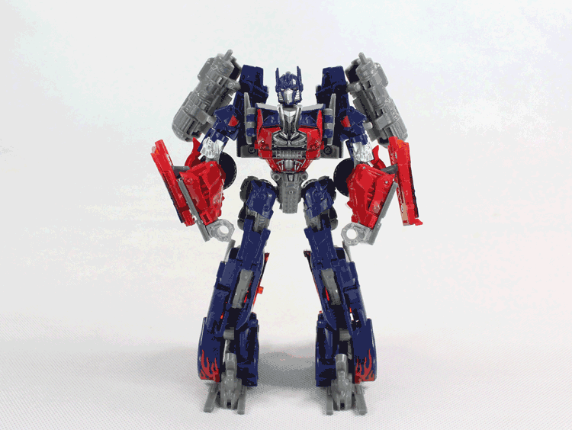
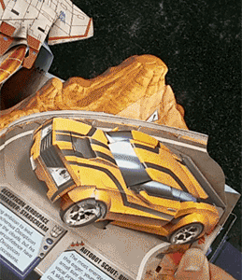

Introduction
What is transforming pop-up?
Transformer toys
Pop-up books
Notes:
Let me first introduce what is transforming popup. It can be thought as a combination of transformer and popup. We know transformers that can transform from one object to another, such as from vehicles and robots. Popup is a form of paper artwork that when you open it, objects such as houses and trees pop up from the page. When these two ideas were combined, we have the transforming popup

Slide 4
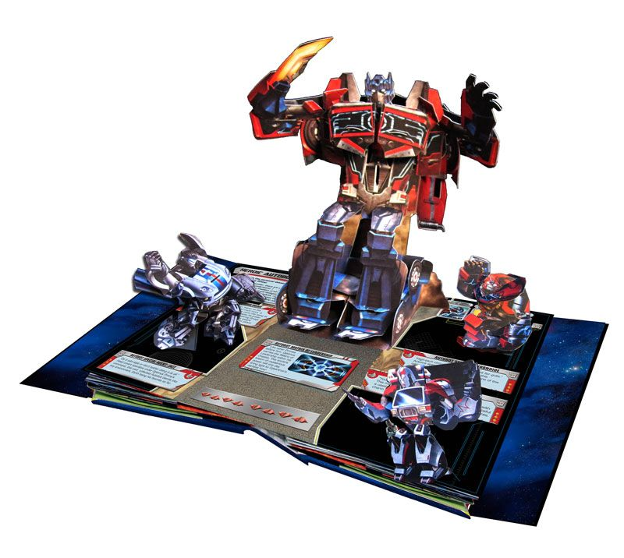
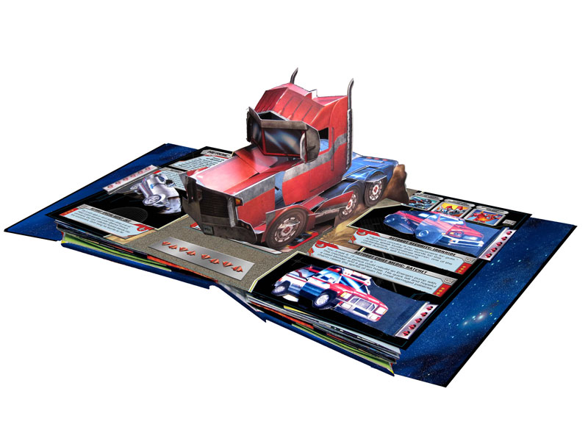
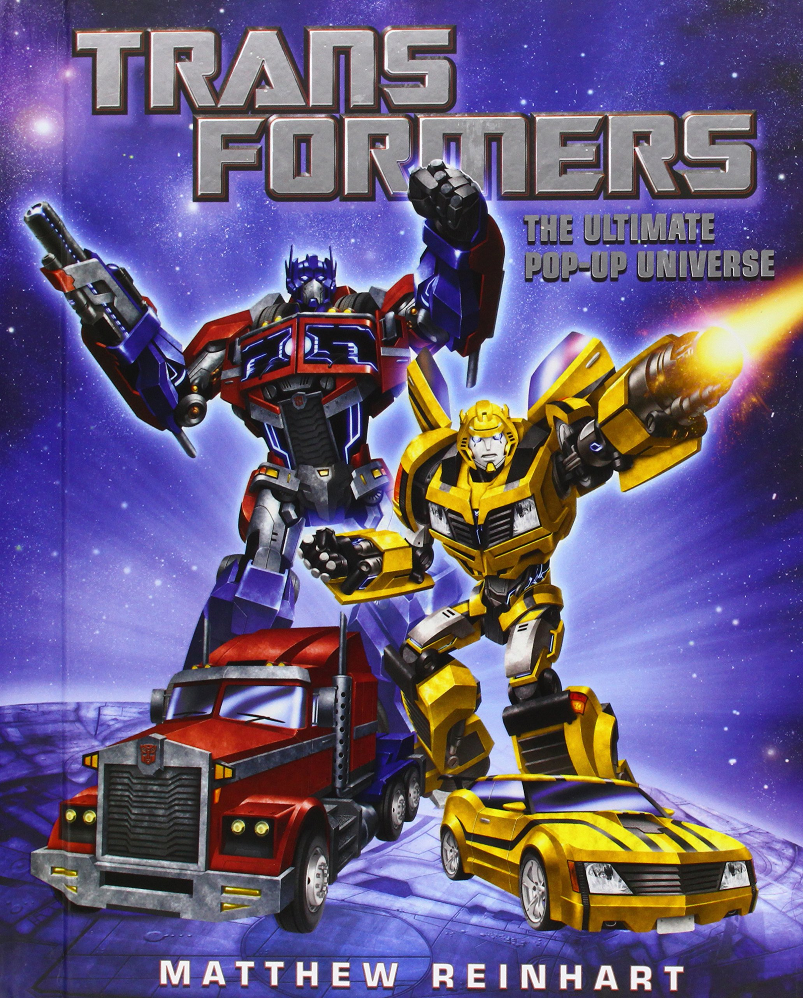
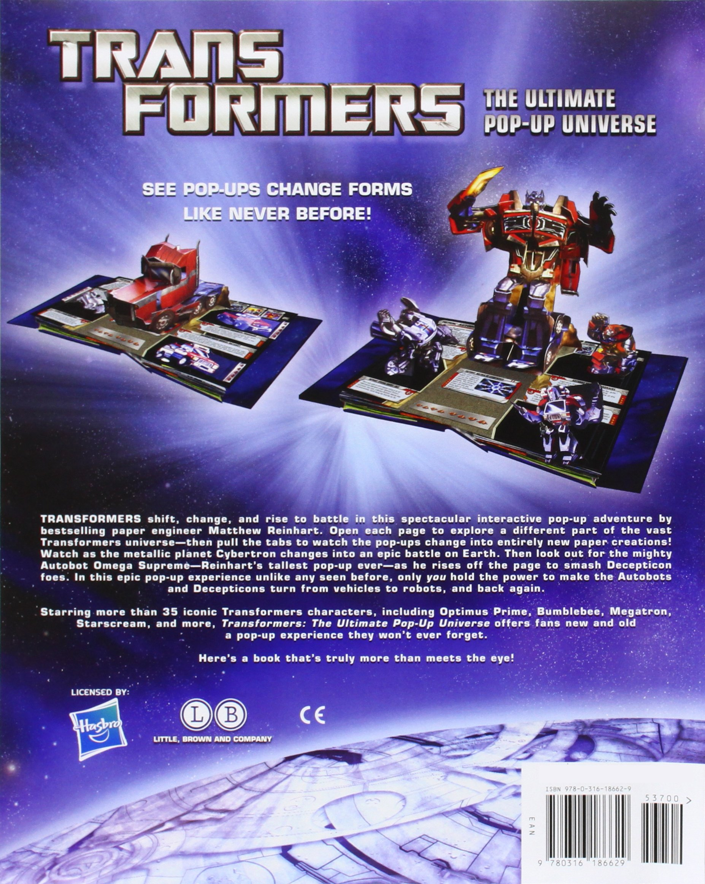
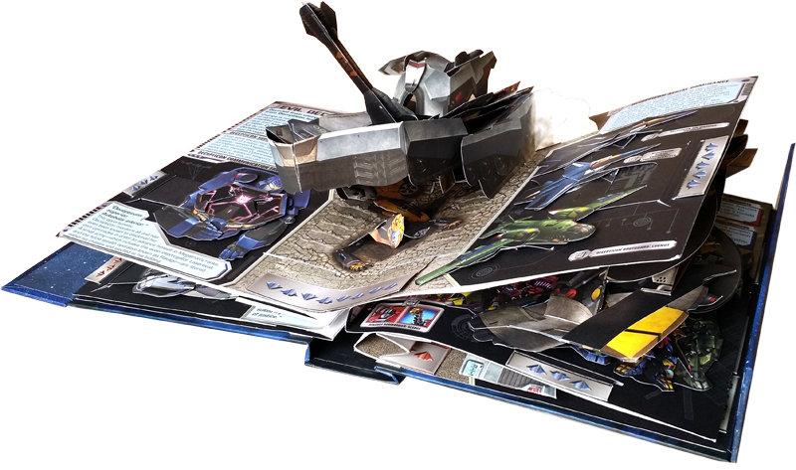
INTRODUCTION
Transforming pop-up by artist
Reinhart, Matthew (2013), Transformers: The Ultimate
Pop-up Universe
Notes:
In 2013 Reinhart published a book named Transformers: The Ultimate Pop-up Universe. This book contains more than 35 iconic Transformer characters. When you pull the tab, you can turn from vehicles to robots, and back again.

Slide 5
INTRODUCTION
Design by artists
Experienced artists often took weeks to manually create them.
Automatic design
We present the first computational tool to help ordinary users create transforming pop-up books, usually several minutes.
Notes:
Creating such a book is a big challenge even for experienced paper artists. To create such popups, you should design necessary mechanisms to create the desired effects, and without interference. This usually means many weeks of trial and error. We proposed an automatic approach for the design of transforming popup. Our tool can be used to help ordinary users create transforming pop-up books, usually several minutes.

Slide 6
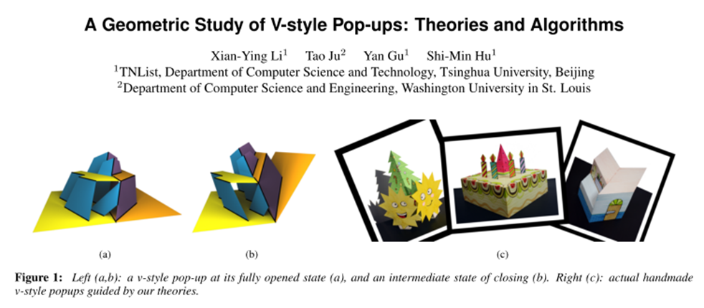
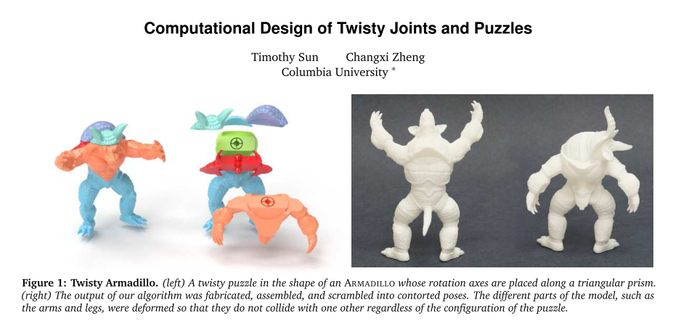
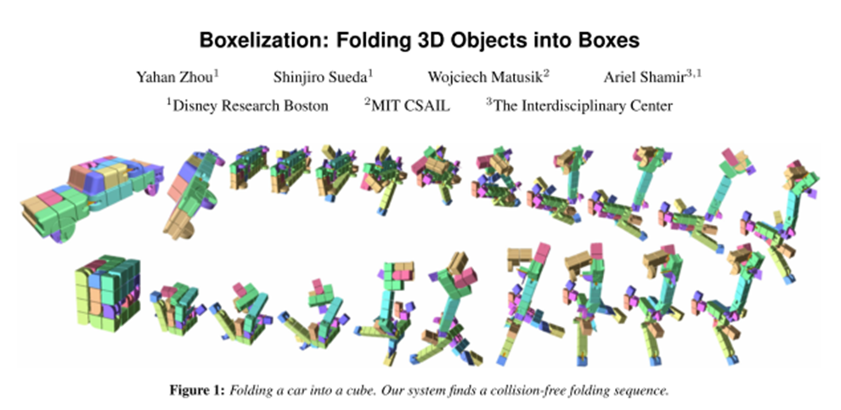
Related work
Computational pop-ups
[Li et al. 2011], [Ruiz et al. 2014], [Le-Nguyen et al. 2013]
Mechanical design & analysis
[Zhu et al. 2012], [G. Winder et al.2009], [Coros et al. 2013]
Folding & combination of objects
[Zhou et al. 2014], [Xin et al. 2011], [McCrae et al. 2011]
Notes:
Researchers have already considered automating the design process for pop-up books. Li et al have studied ordinary popups and V-fold popups and more recently slice-form popup has been studied. In mechanical design and analysis approaches have been proposed for automatically generating mechanism assembly. Given a designer specified geometry and motion for a toy, Zhu et al provide an approach to automatically generate a mechanism assembly located in a box below a toy character. Winder et al performed kinematic simulation to ensure that the fabricated toy functions properly. However, their approach can only handle simple motions. Coros et al. allow more complex, user-defined motions, but they must still be cyclic. Our work is also related to folding and combination of objects, and they are inherently suitable for papers. Works such as transforming a 3D object into a cube and generating 3D models composed of interlocking planar pieces have been studied recently.

Slide 7
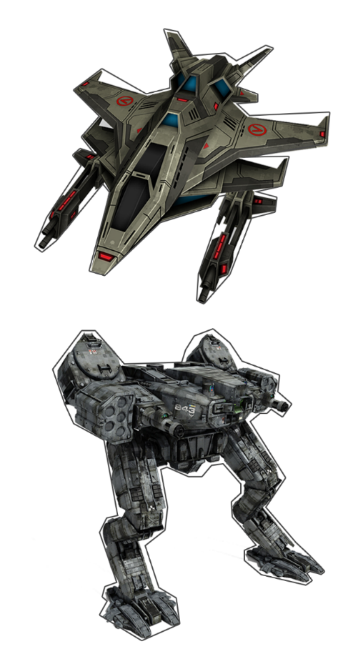
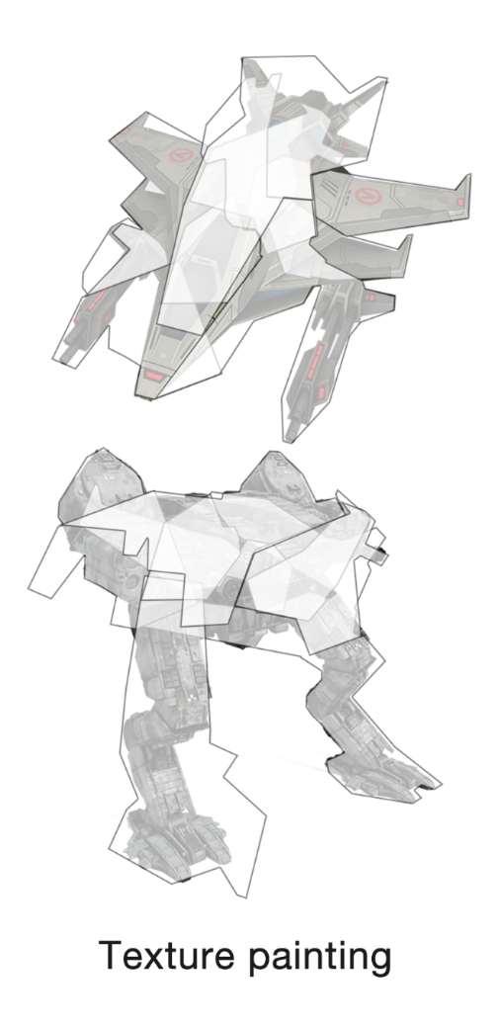
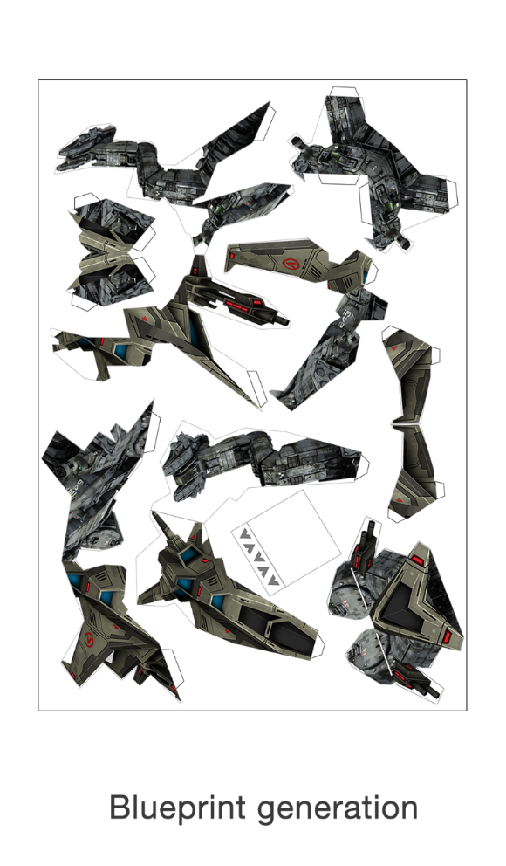
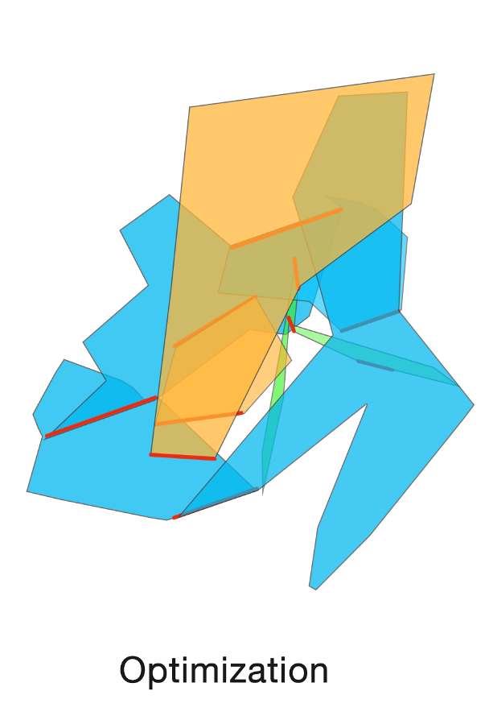
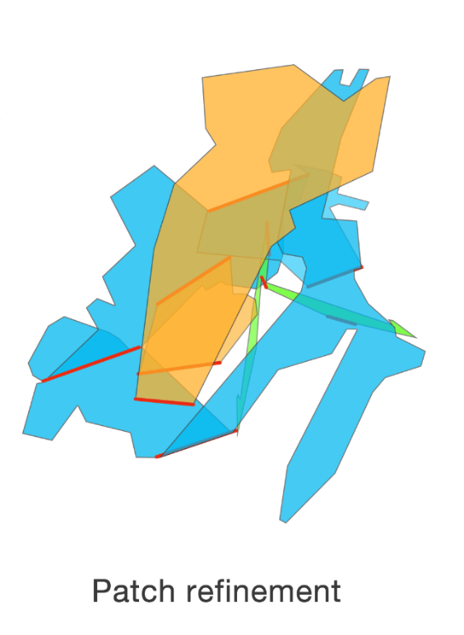
overview
Notes:
Our approach works as follows. Given two input patterns, we solve an optimization problem, to get a structure that can smoothly transform in 3D from one pattern to the other. Then we refine the results and paint the texture. The final output is a blueprint that user can use it to fabricate the transforming popup.

Slide 8
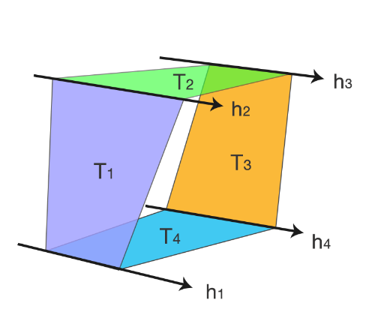
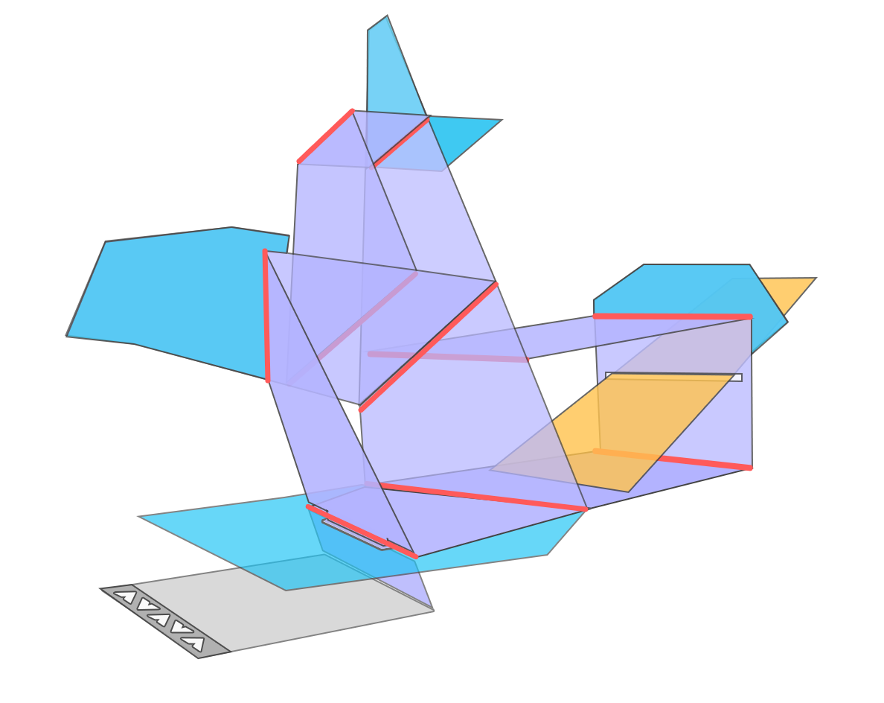
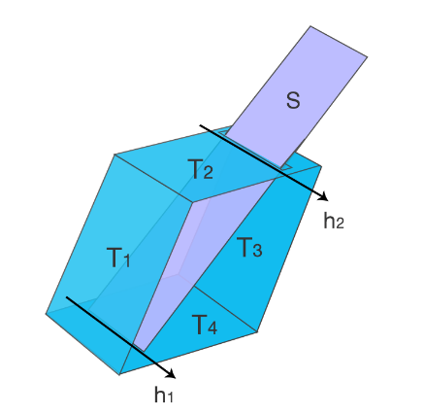
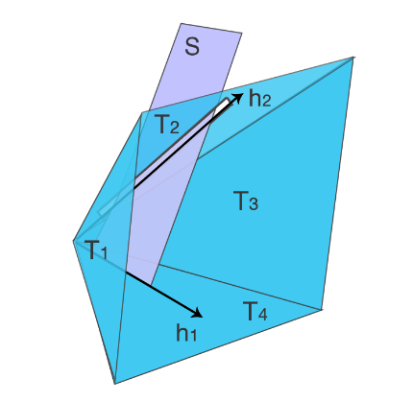
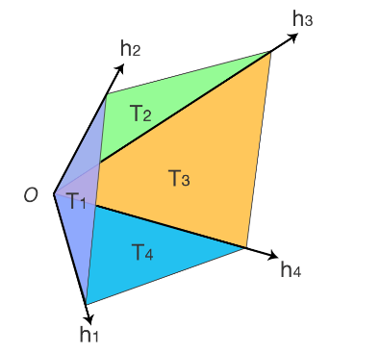
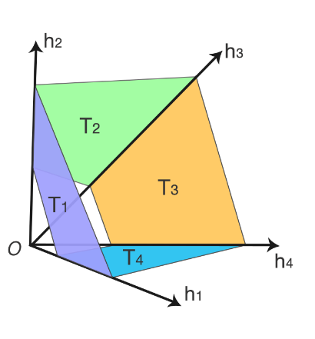
Basic mechanisms
Parallel mechanism
Slide mechanism
V-fold mechanism
Notes:
The transforming popup is composed of three basic mechanisms. We call them parallel mechanism, slide mechanism and V-fold mechanism. A parallel mechanism is
composed of four quadrilateral patches connected cyclically by four hinges. All four hinges are parallel. A V-fold mechanism is also composed of four patches with four hinges, the lines containing the four hinges intersect at a single point. Slide mechanism is based on parallel mechanism or V-fold mechanism. In addition, a rectangular patch is placed in one of the four patches of the parallel or V-fold mechanism.

Slide 9
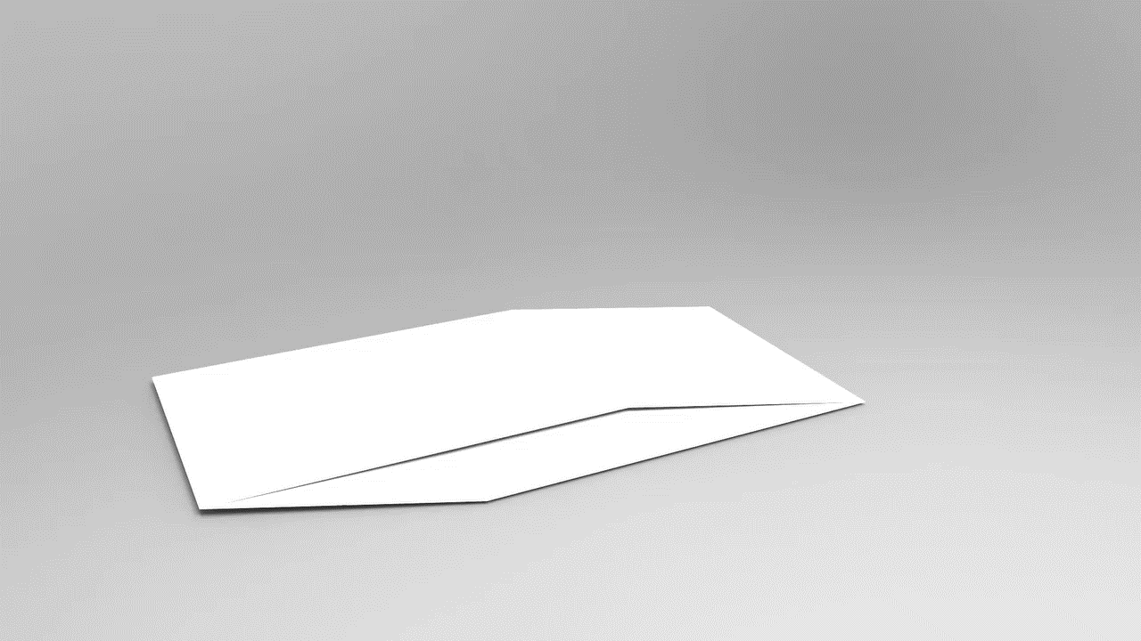
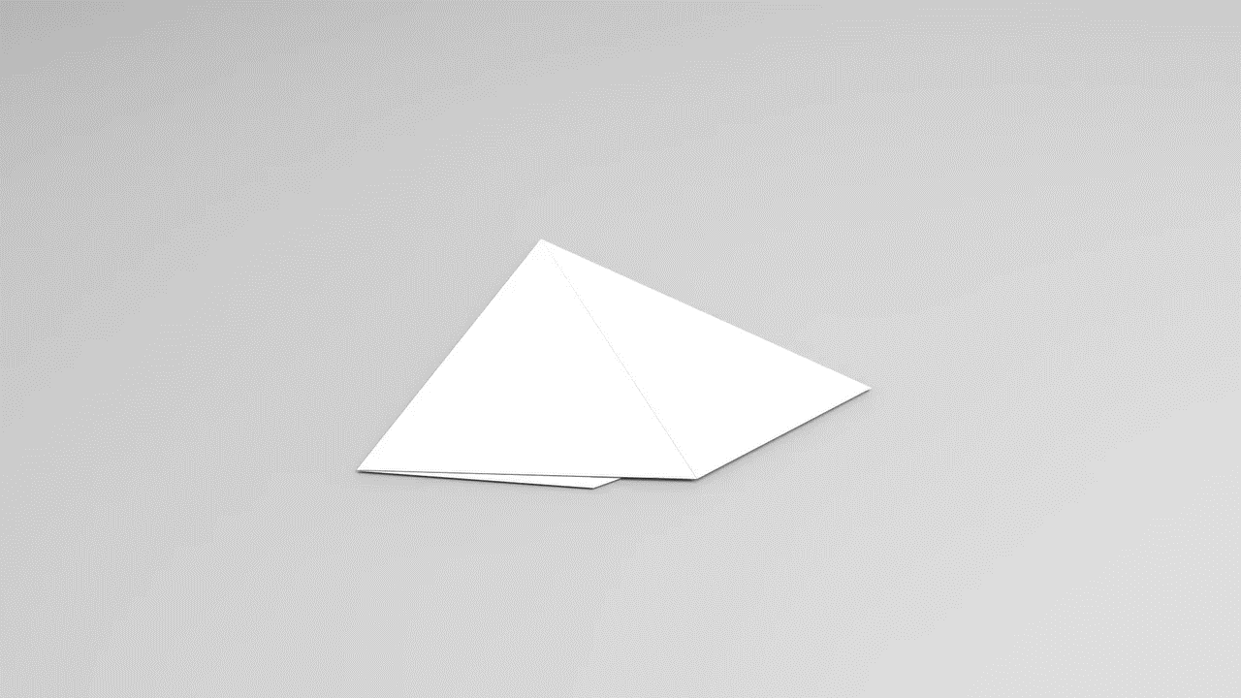
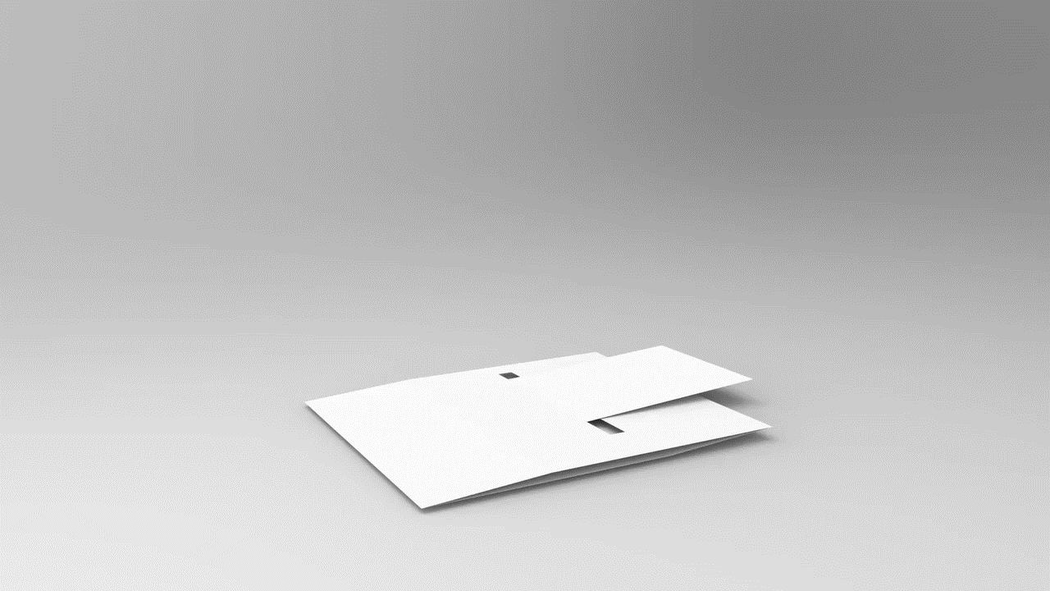
Basic mechanisms
Parallel mechanism
V-fold mechanism
Slide mechanism
Notes:
Here is a demo to show how these basic mechanisms work

Slide 10
Functional elements
Extended Patch
Pull-tab
Notes:
In addition to the above basic mechanisms, we also make use of functional elements. Extended patch is attached to the patches of a parallel mechanism or V-fold mechanism and lies in the same plane. This allows for more flexibility. The pull-tab is a rectangular patch that the user pulls (or pushes) to actuate transformation of the pop-up.

Slide 11

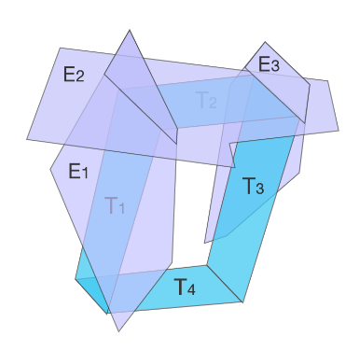
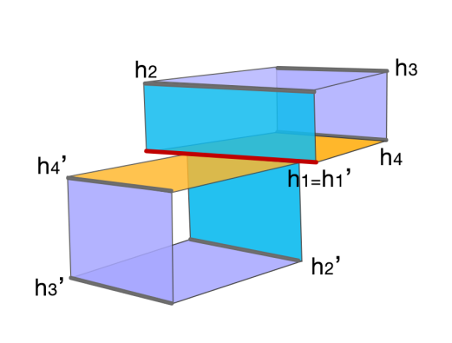
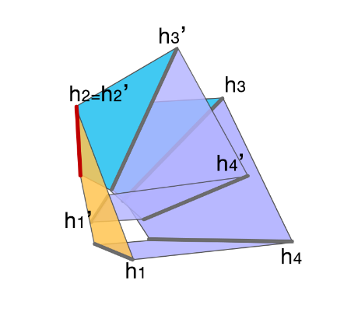
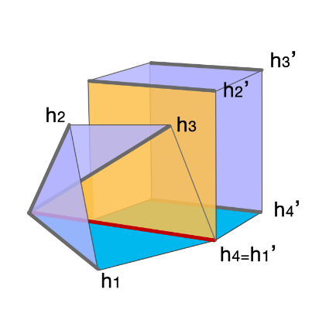
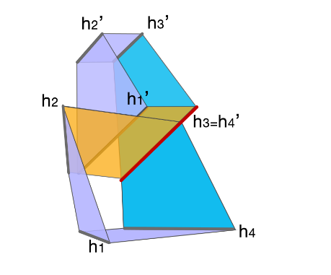
Linkage
Slide linkage
Extended Patch Linkage
Hinge Linkage
Notes:
The overall transforming pop-up is constructed by linking basic elements. We define three types of linkage: slide linkage, extended patch linkage and hinge linkage. The slide linkage and extended patch linkage are rather straightforward. Hinge linkage can be regarded as two basic mechanisms sharing a hinge line while neighboring patches being coplanar.

Slide 12
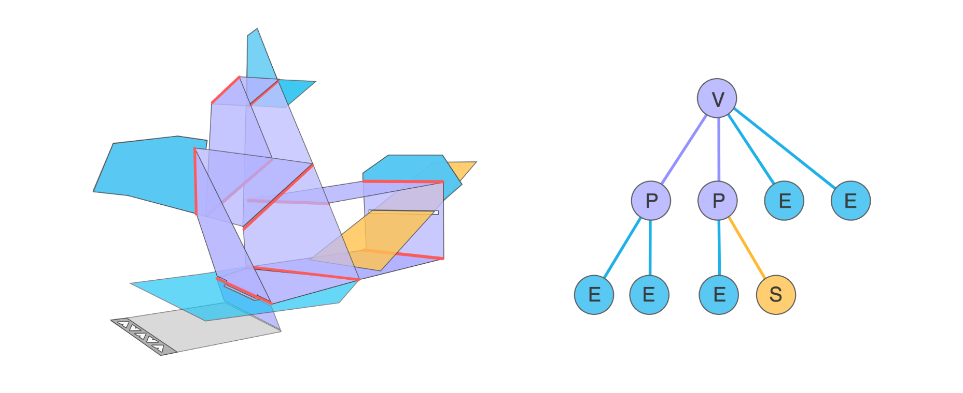
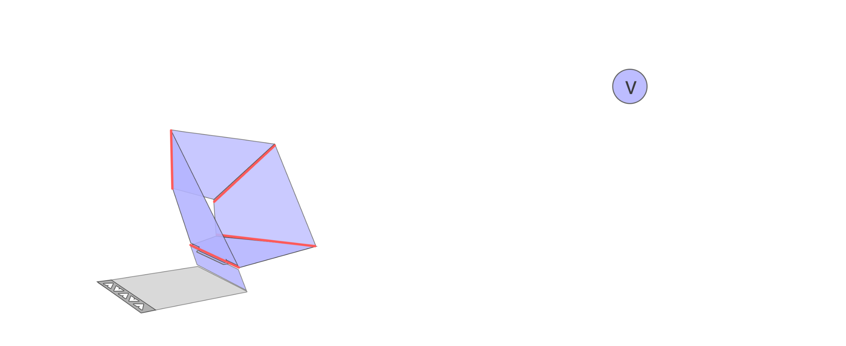
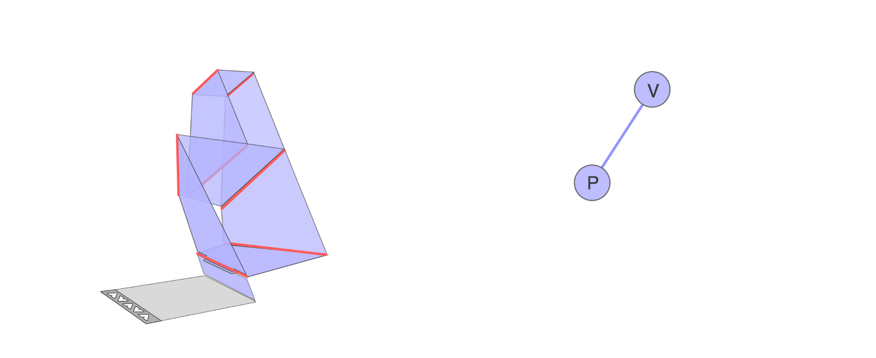
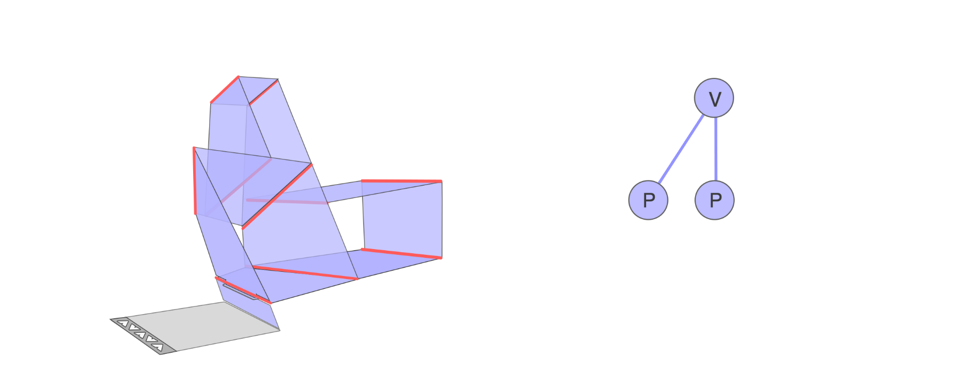
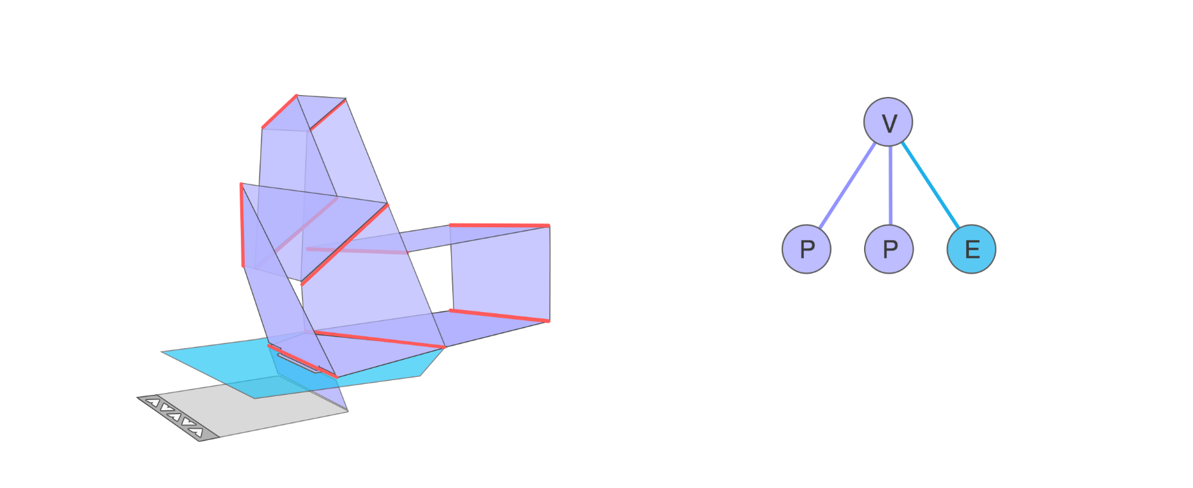
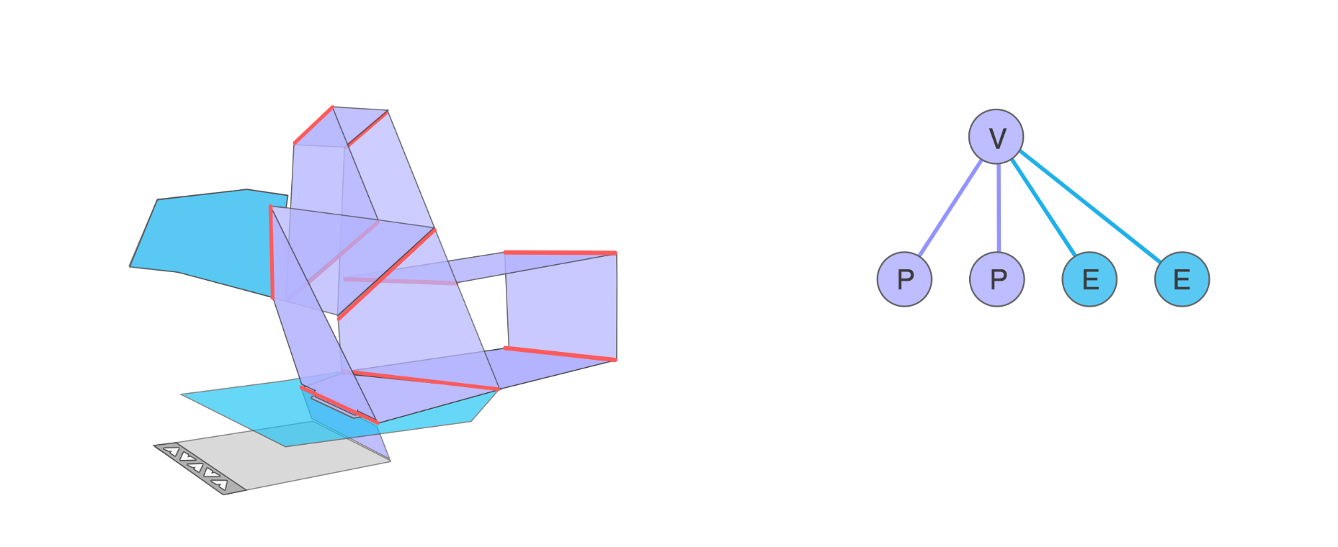
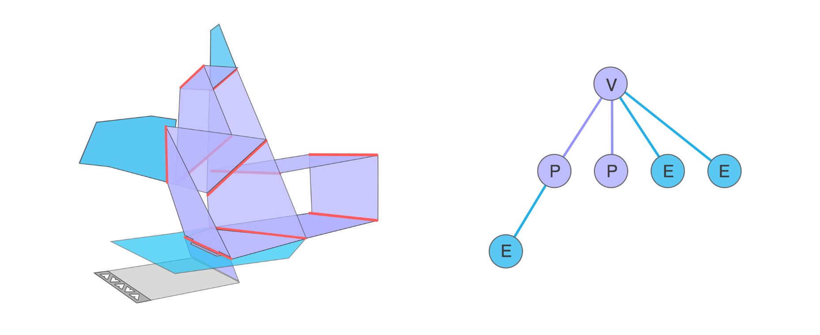
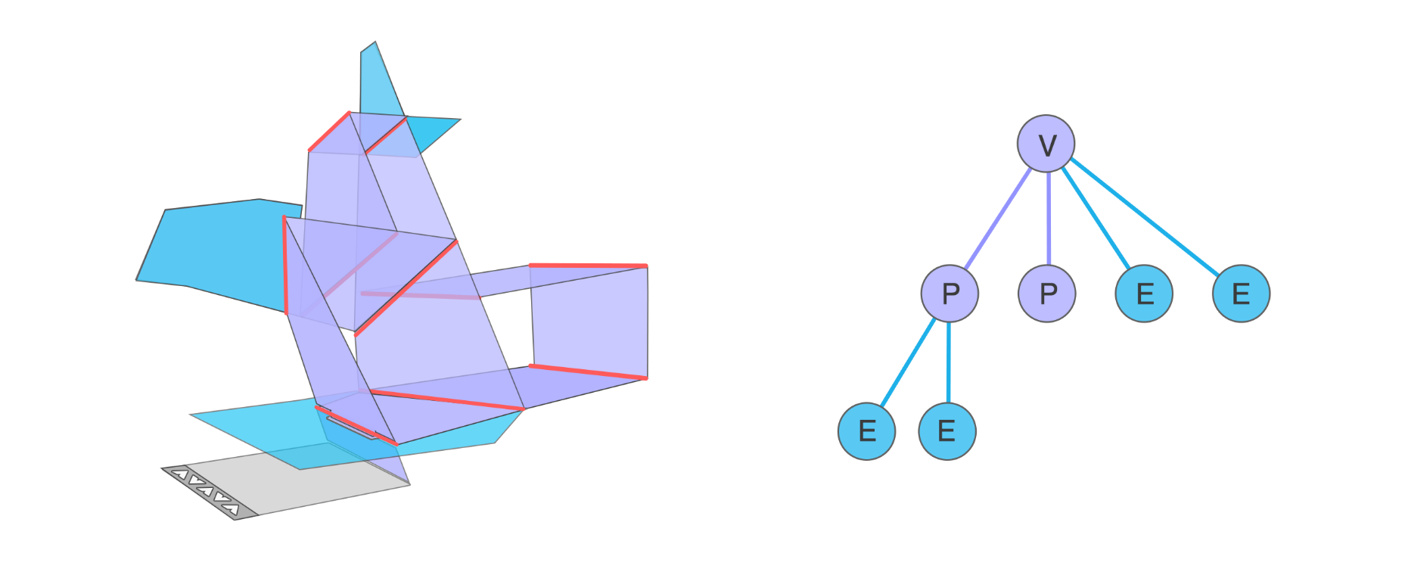
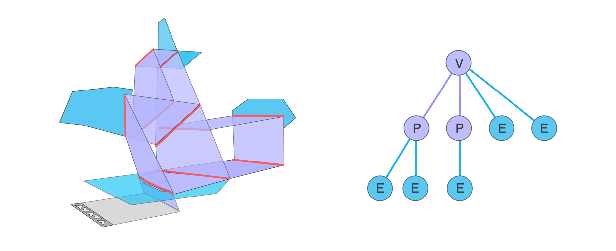
Linkage tree
Notes:
Then the overall transforming popup can be regarded as a linkage tree. In the linkage tree each node represents a basic mechanism or functional element, and each edge represents a linkage. Now the problem is to construct such a linkage tree that the represented structure can transform from one pattern to the other. We adopt an energy minimization approach and next I will introduce the energy terms in detail.

Slide 13
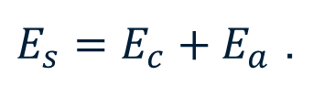
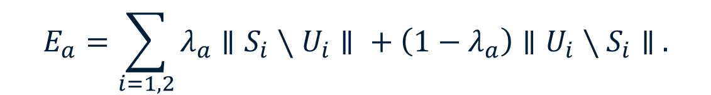
Energy function
Shape term
The shape matching cost is defined in terms of a contour matching cost and an area matching cost:
The contour matching cost is computed using the shape context method and is given by:
The area matching cost measures the difference of region coverage between the pop-up and user given patterns. It is computed as:
$E_{s}=E_{c}+E_{a}$ .
$$E_{c}=D\left(S_{1},U_{1}\right)+D\left(S_{2},U_{2}\right) ,$$
$$E_{a}=\sum_{i=1, 2}{λ_{a}∥S_{i}}∖U_{i}∥ + \left(1−λ_{a}\right)∥U_{i}∖S_{i}∥ .$$
Notes:
The shape term encourages the popup in the untransformed state and transformed state to match the shape of the user given source pattern and target pattern. The contour matching is computed using the shape context method and the area matching cost is measured using the difference of region coverage between the popup and user-defined patterns.

Slide 14

Energy function
Flip term
The flip term is simply defined as the sum of the areas of all regions which violate the flip constraint:
$$E_{f}=\sum_{i}{∥R_{i}}∥ .$$
Notes:
Flip term is used to encourage each patch of the structure to flip after transformation. This is because visible regions in untransformed and transformed states are painted with source and target pattern textures, if a patch does not flip, it will cause conflict in texture painting. The flip term is simply defined as the sum of the fractional areas of all regions that violate this constraint.

Slide 15
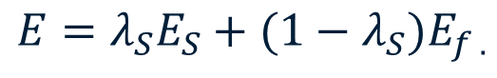
Energy function
Total energy:
The energy function E is defined as the sum of a shape term and a flip term:
If collision was detected, we give the energy function E a very large value.
$$E=λ_{S}E_{S}+(1−λ_{S})E_{f .}$$
Notes:
The total energy function is defined as the sum of a shape term and a flip term. If collision was detected, we give the energy function a very large value. We used the OBB tree to detect collision.

Slide 16
Energy minimization
Basic approach
Directly use a genetic algorithm(GA)
Random initialization
Use −E(x) as fitness function.
Time consuming
Tens of hours per case.
Notes:
To minimize the energy function, we iterate over all possible linkage tree configurations up to a certain maximum size. For each configuration we can directly use a genetic algorithm. However this is time consuming and usually costs tens of hours per case.

Slide 17
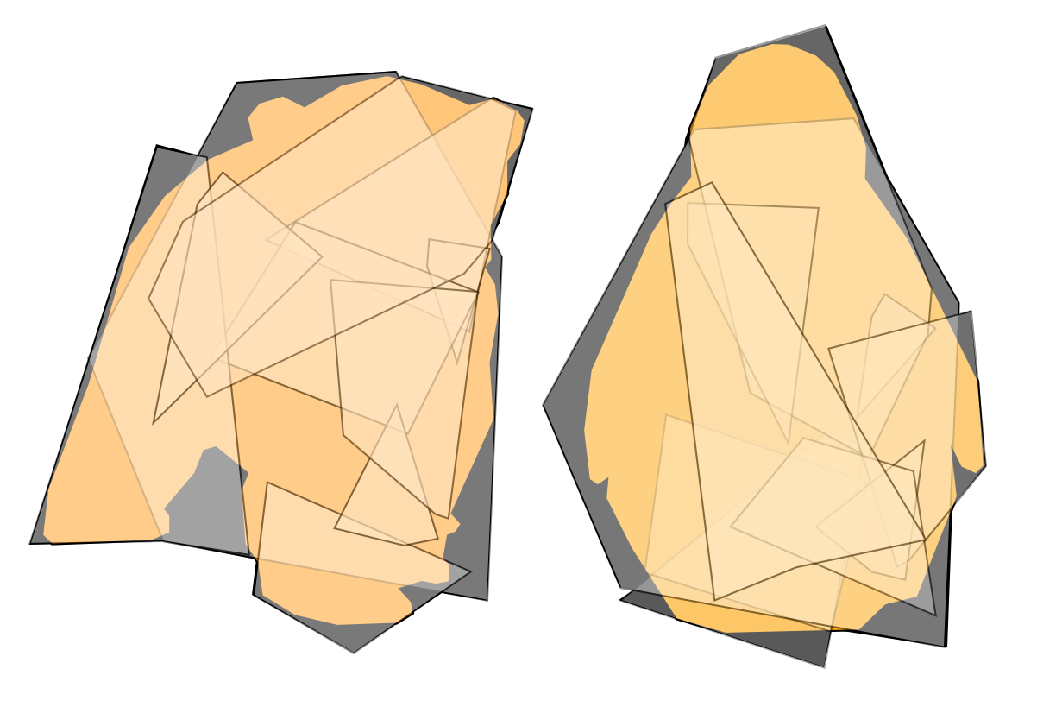
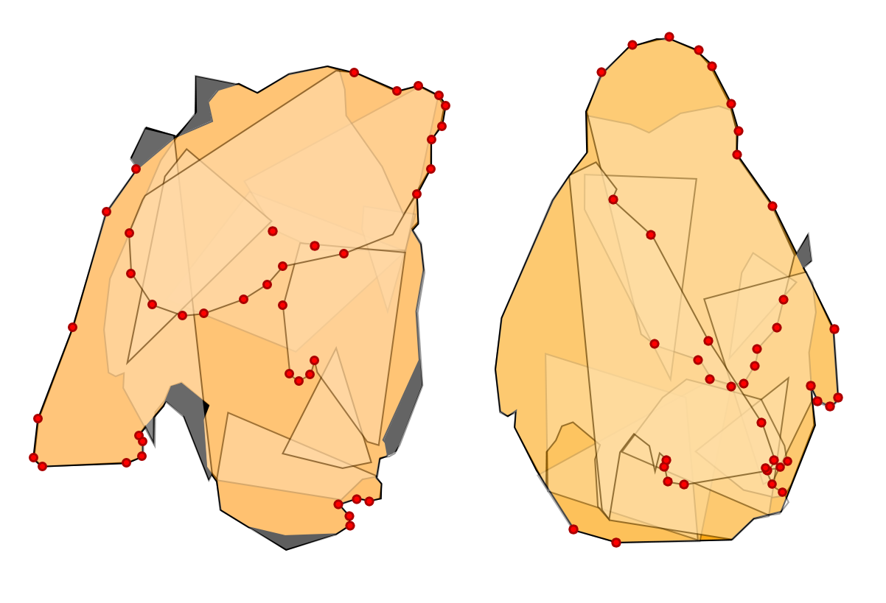
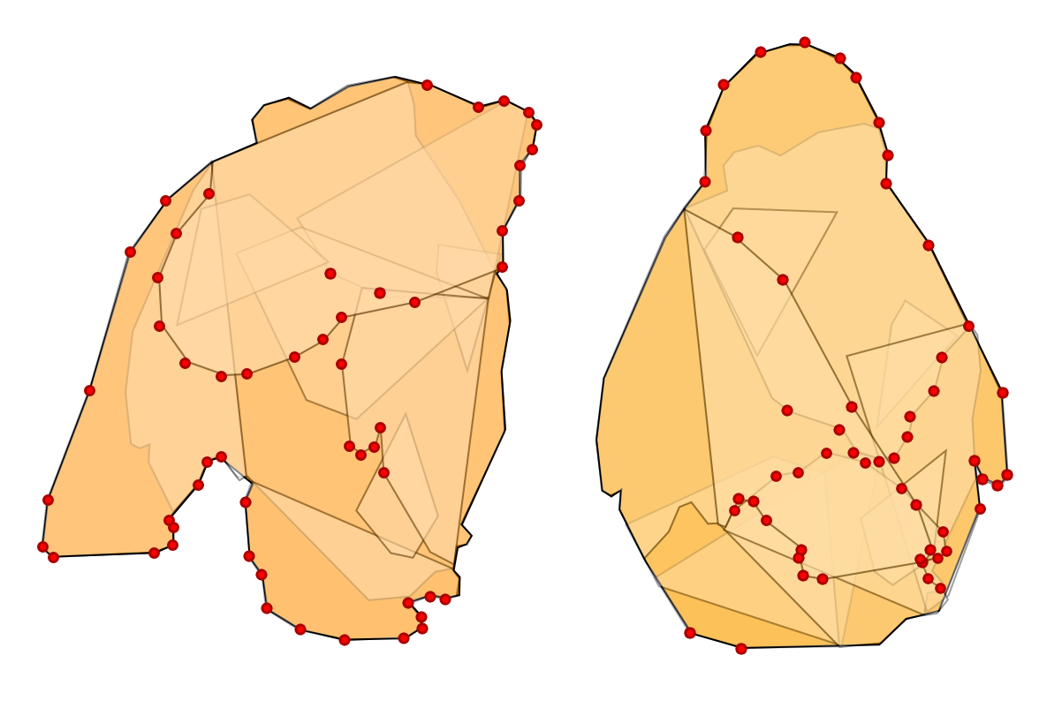
Energy minimization
Acceleration
Observation
The GA after a few generations obtains an adequate global structure for the whole mechanism, but takes much longer to optimize in detail the vertex positions of each patch.
Greedy strategy
Notes:
To accelerate the basic approach, we use a greedy strategy based on the following observation: The GA after a few generations obtains an adequate global structure for the whole mechanism, but takes much longer to optimize in detail the vertex positions of each patch. During optimization, we detect good patch vertices as the GA iterates and fix them to reduce the dimensionality of the solution space. Generally speaking they are vertices that lying on the boundaries of the input patterns. Some good vertices are illustrated as red dots in the figure.

Slide 18
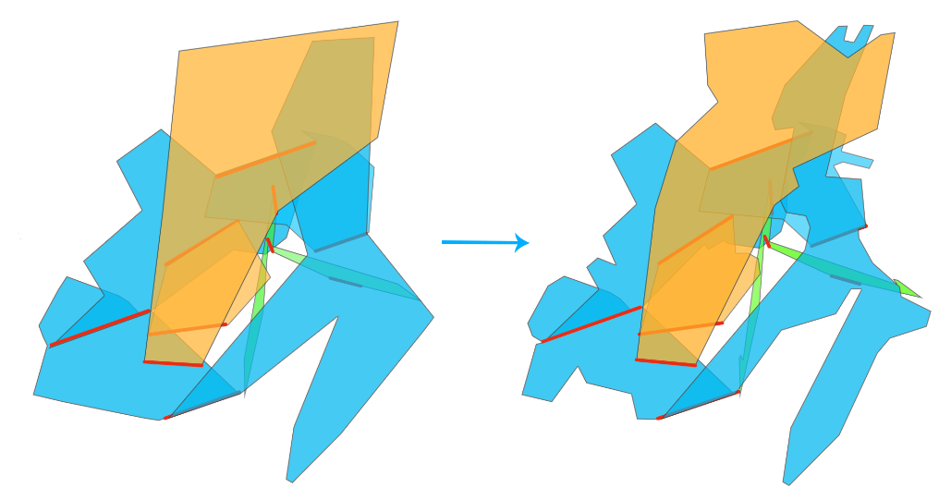
Patch Refinement
The purpose of this step is to reduce the size of the redundant regions.
Deal with redundant regions for the untransformed state and for the transformed state in turn.
For the untransformed state, crop all redundant regions, except for those parts that belong to visible regions in the transformed state.
Redundant regions in the transformed state are cropped in an analogous way.
Notes:
The initial transforming pop-up obtained by the optimization approach maybe coarse, and we perform a patch refinement step to reduce the size of the redundant
regions. We summarize 3 principles as follows. We deal with redundant regions for the untransformed state and for the transformed state in turn. For the untransformed state, we crop all redundant regions, except for those parts that belong to visible regions in the transformed state. Redundant regions in the transformed state are cropped in an analogous way.

Slide 19
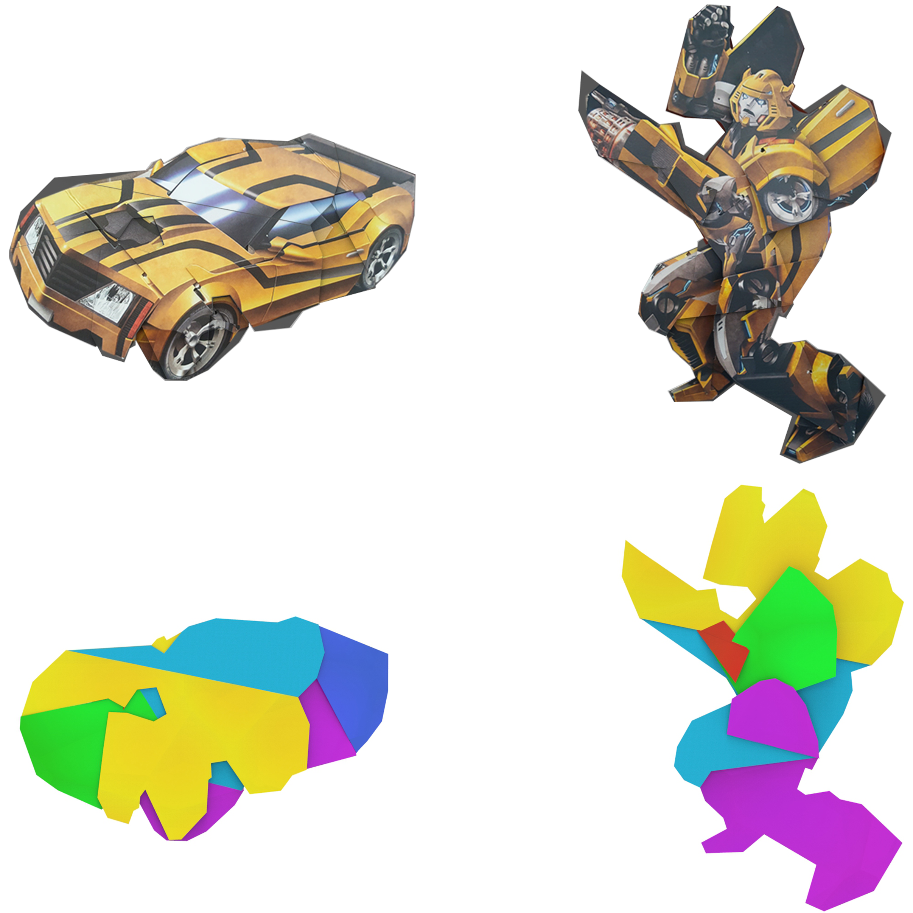
Texture Painting
Texture painting is done for each face in turn.
Visible (or partially visible) in both states.
Only visible (or partially visible) in one state (untransformed or transformed).
Invisible in both states.
Notes:
After determining the mechanism, we must paint the user provided textures onto the patches. Except those patches visible in the untransformed and transformed states, all other patches should also be painted to make the intermediate appearance look more natural during the transformation process. We consider 3 situations: patches that are visible in both states, only visible in one state and invisible in both states. For patches that are visible in both states, the parts only visible in the untransformed or transformed state are painted using source or target pattern, respectively. For patches that are only visible in one state, the whole face is painted using a single texture. For patches that are invisible in both states: The whole face is painted using the source pattern.

Slide 20
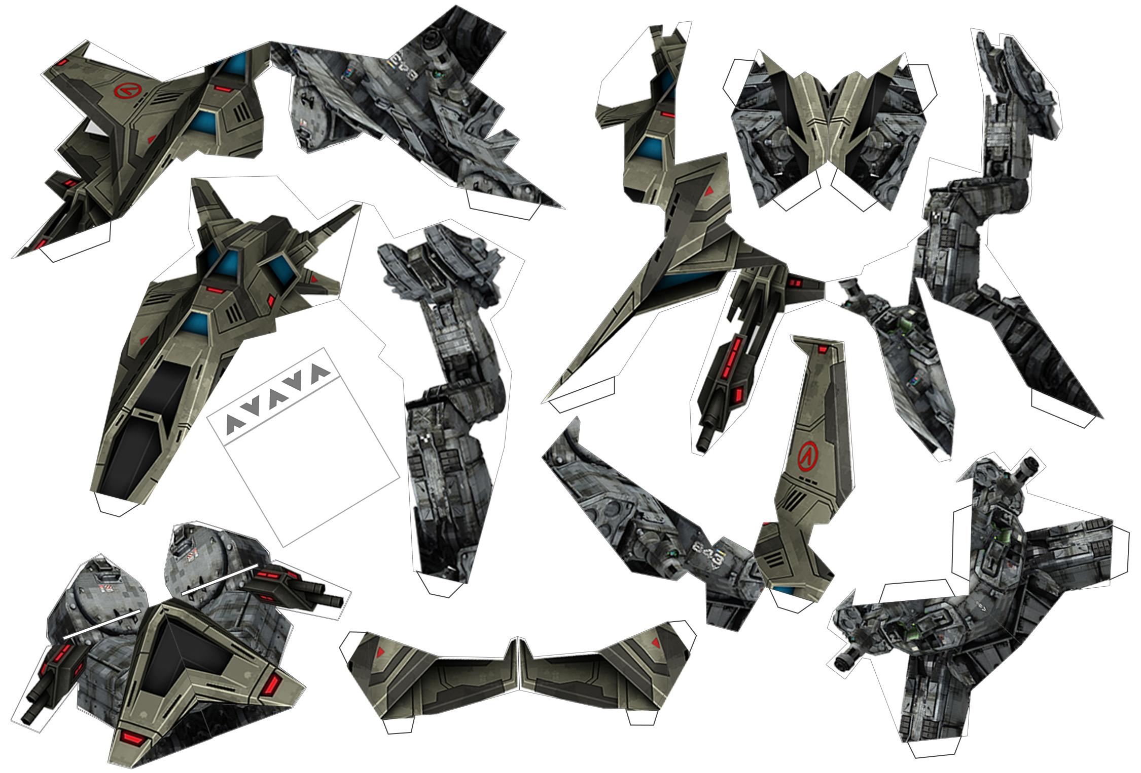
Blueprint Generation
Not use duplex printing, since registration is typically imperfect.
The pull-tab is manually designed.
Notes:
Finally we generate the blueprint. We do not use duplex printing since registration is typically imperfect. The pull-tab is manually designed.

Slide 21
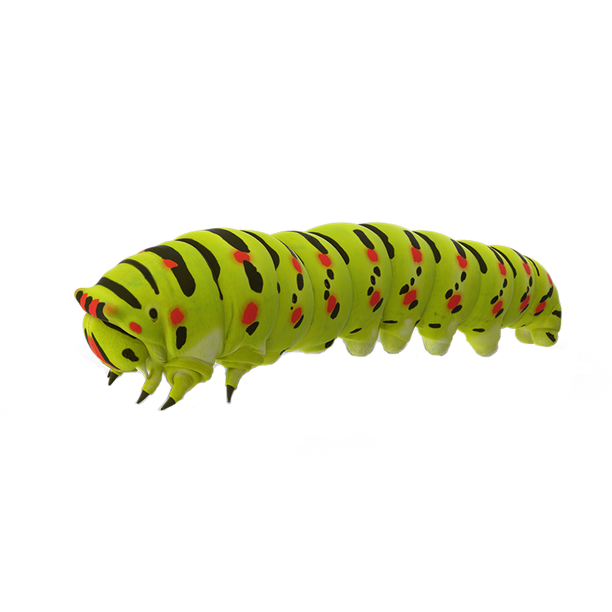
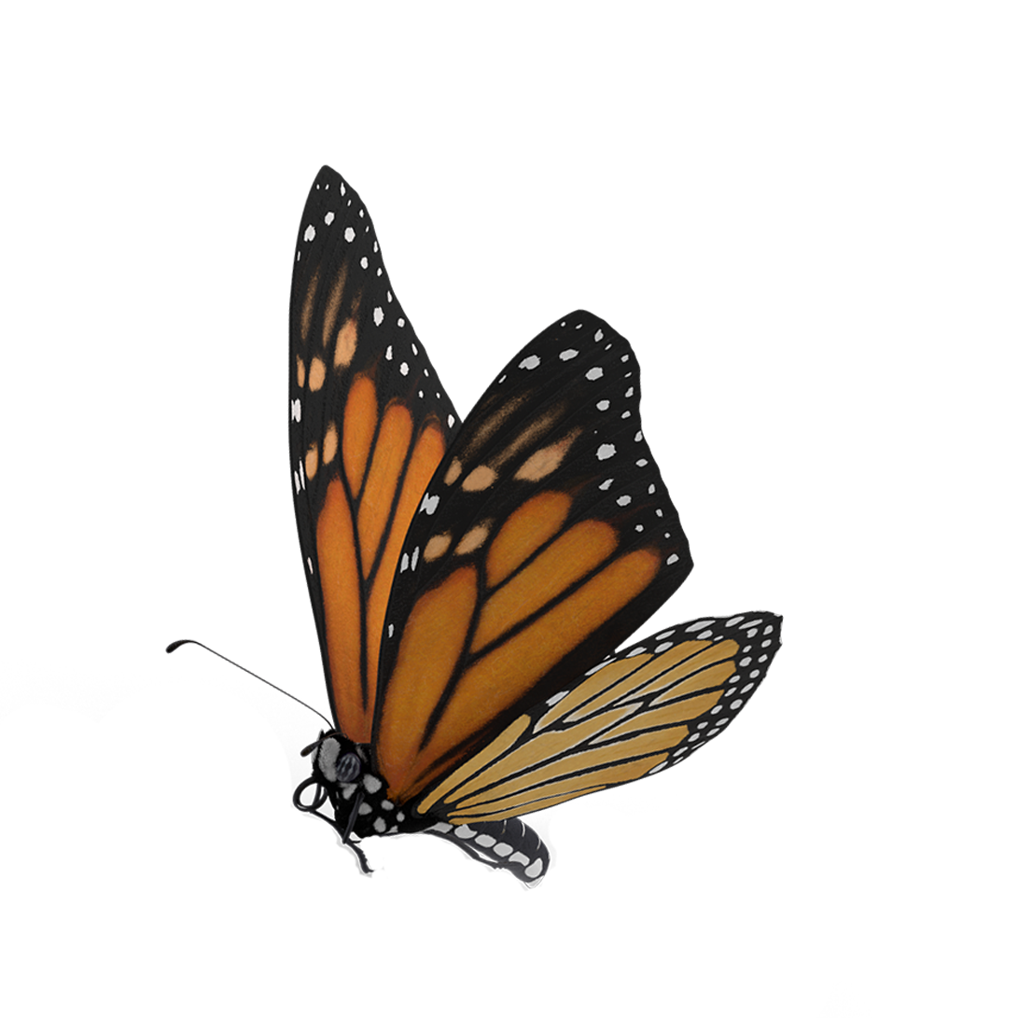

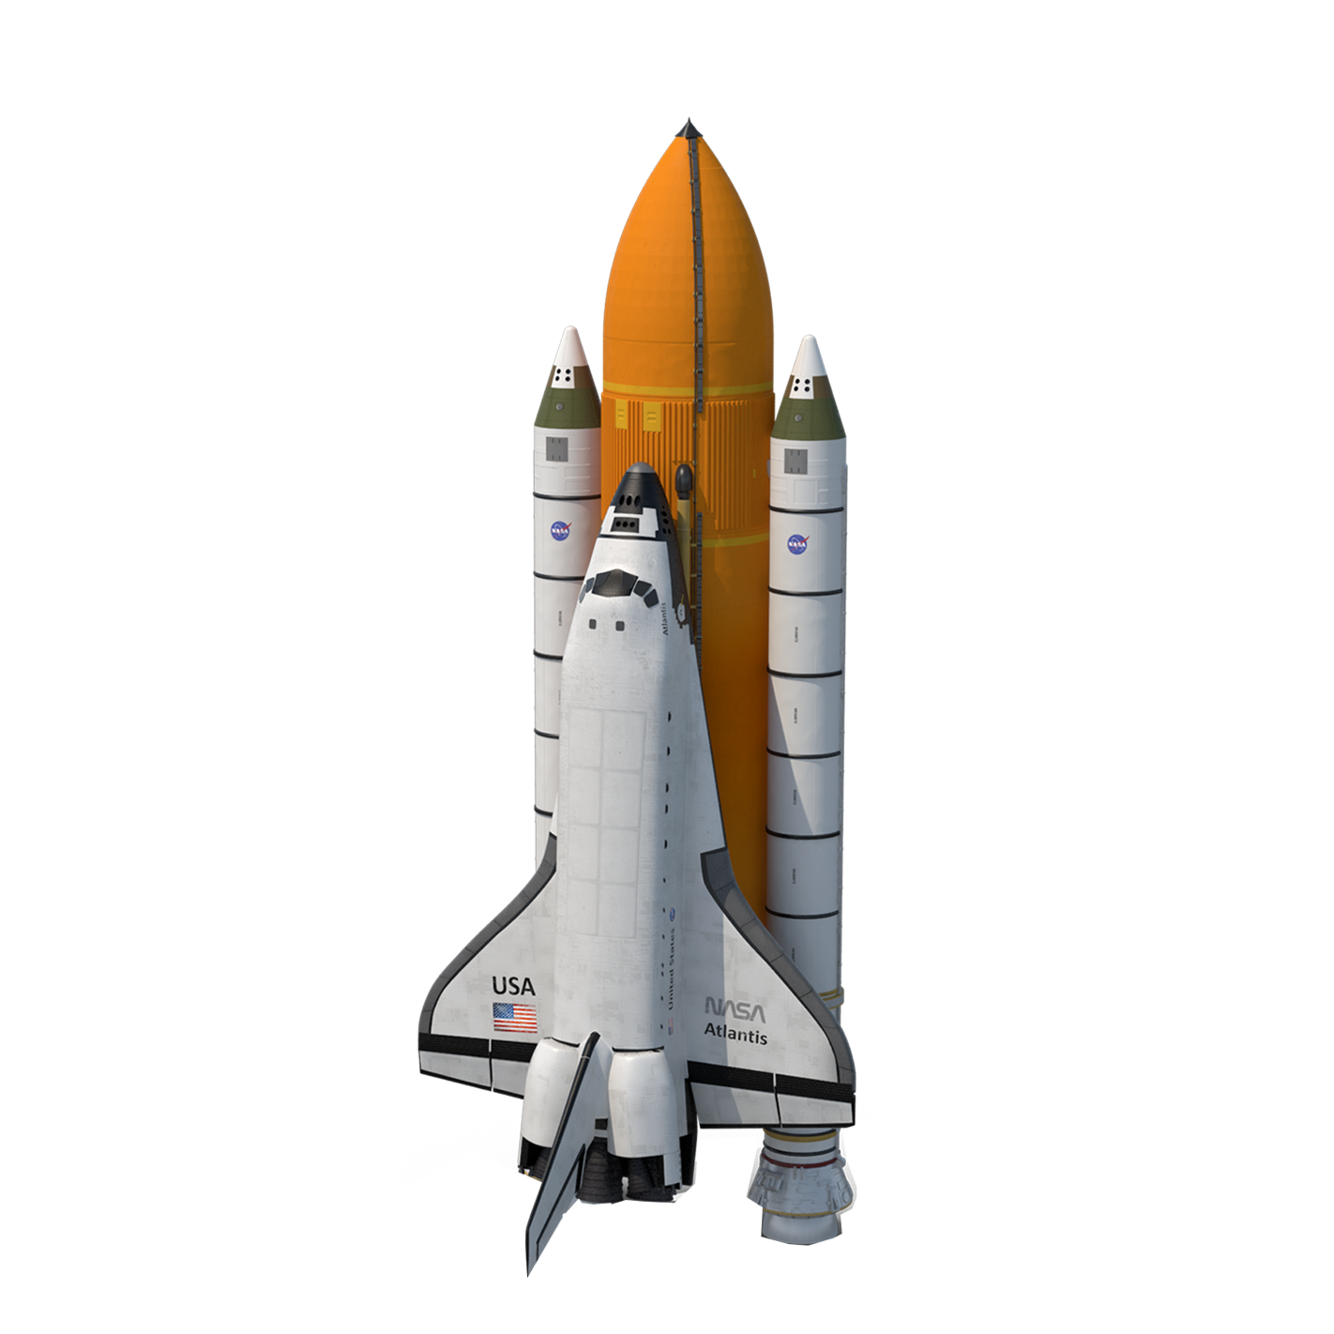


EVALUATION
Naïve vs accelerated
Example |  | Time
 | naive | 14h
 | accelerated | 17min
 | naive | 14h
 | accelerated | 10min
 | Naïve | 16h
 | accelerated | 10min
Notes:
The accelerated approach is 5 - 10 times faster than naïve approach. When implemented in GPU, it provides another 10 times speedup. Thus the accelerated approach can provide in total 50 – 100 times sppedup.

Slide 22





EVALUATION
Number of basic mechanisms
Num. of Mech.: 1
Num. of Mech.: 2
Num. of Mech.: 3
Num. of Mech.: 4
Num. of Mech.: 5
Notes:
As mentioned above, we have set a maximum number of basic mechanisms. Here we give the results with different number of basic mechanisms using the same input
patterns. Using less mechanisms result in obvious redundant regions but more mechanisms will increase the computation time dramatically. We find 5 is a good balance.

Slide 23

Results
Simple examples
Notes:
Here are some simple results: the transformation between basic shapes.

Slide 24

Results
Simulated examples
Notes:
This example shows the transformation from a car to a robot.

Slide 25

Results
Simulated examples
Notes:
This example shows the transformation from a sphinx to a mask.

Slide 26

Results
Simulated examples
Notes:
And this example shows the transformation from a caterpillar to a butterfly.

Slide 27

Results
Simulated examples

Slide 28


Results
Fabriacated examples
Notes:
Here we show two fabricated examples.

Slide 29


Results
With ground collision check
Notes:
We show two results with ground collision check.

Slide 30

Results
Failure case
Notes:
For extreme cases our approach will fail. For example here the shape of the heart and rose differs greatly and our approach produce result with large redundant regions.

Slide 31
Conclusion
We have presented an approach to automatically generate transforming pop-ups.
We assume paper thickness to be zero, this might cause the fabricated mechanism to fold improperly.
In the future, we plan to investigate transformations between 2D patterns and 3D shapes, as well as between 3D shapes.
Notes:
In conclusion we have presented an approach to automatically generate transforming pop-ups. Our approach has some limitations. We assume paper thickness to be zero, this might cause the fabricated mechanism to fold improperly. In the future, we plan to investigate transformations between 2D patterns and 3D shapes, as well as between 3D shapes.

Slide 32
Thanks for listening

